Slide 1
ARS Compliance Portal Training Session (2024 Update)
Cameron Chung
Senior Specialist (O&P), Compliance Monitoring - Law
Jane Mahilom
Compliance Monitoring Analyst, Compliance Monitoring - Law
Shuchismita (Shuchi) Singh
Senior Business Analyst - IT Corporate Cloud Services & Business Analysis

Slide 2
The Plan
At the end of this tutorial, you will be able to:
Identify the new functionalities made available to you as part of the recent portal update.
Understand / Refresher on Designated Document Provider (DDP) Relationships.
Update the Registration Information on your company’s portal profile.
Establish New DDP Relationship using the Portal.
Terminate DDP Relationship using the Portal.

Slide 3
Agenda
Why the Changes?
What’s New?
What are Designated Document Provider (DDP) Relationships?
Question
MP Registration Update Demo
Establishing New DDP Relationship Demo
Terminating Existing DDP Relationship Demo
Question & Feedbacks

Slide 4
Why the Changes?
Continuous improvement of service
Reduction of paperwork and regulatory burden
Journey to a single source of truth

Slide 5
What’s New?
MP Self-Serve: Ability to update your company’s registration information
Corporate Address details
Contacts Primary, Alternate, Authorizing Officer, and additional contacts.
Create new contacts
Establish delegation for Authorizing Officer
Add MP comments under FE details
as a good practice, MP should use this field to provide notes on the updates they make to their registration
#1
All market participants are expected to keep their profile information up to date.

Slide 6
What’s New?
Designated Documentation Provider (DDP) Module
Ability to establish and terminate Designated Documentation Provider (DDP) Relationship with another Registered Entity
#2

Slide 7
What are Designated Document Provider (DDP) Relationships?
Provider
Designator
AESO

Slide 8
What are Designated Document Provider (DDP) Relationships?
Did Susie do something bad?
Designator
(Susie)
Provider
(Jenny)
DDP - Permission to communicate & provide evidence
AESO

Slide 9
What are Designated Document Provider (DDP) Relationships?
A Designated Document Provider (DDP) Relationship refers to the authorization conferred by one party (Designator), to another party (Provider), enabling the latter to communicate and furnish evidence on behalf of the former.

Slide 10
Designated Document Provider (DDP) Relationships - Communication
Communication | Designator | Provider
Audit/Self-Certification Notification | YES | YES – Notification of provision of CMP information
Audit/Self-Certification Scope | YES | YES – Notification of provision of CMP information
Incomplete Submittals | NO | YES
Information requests | NO | YES
Draft report | NO | YES
Final Report | No | YES
Referral | No | YES

Slide 11
Designated Document Provider (DDP) Relationships - Schedule
There are two types of DDP schedules.
(The difference is in the timing of compliance monitoring activities.)
Provider Schedule
99% of DDP relationship
Available through the portal
Designator Schedule
Currently unavailable through the Portal
Contact AESO@
rscompliance@aeso.ca,
arsportal@aeso.ca)

Slide 12
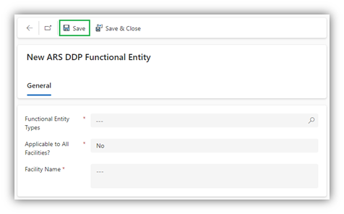
Document Provider (DDP) Relationships - Scope
DDP can be established for all, or certain facilities owned / operated under a functional entity

Slide 13
Document Provider (DDP) Relationships - Life Cycle
There are two stages of any DDP relationship.
Stage 1
Stage 2
Creation / Acceptance
Termination
Can be started by either provider or designator
Can be triggered manually or by expiry
Default expiry date is set as 12/31/2999

Slide 14
Questions before the Demo?

Slide 15
DEMO - MP Registration Update - Establishing New DDP Relationship - Terminating DDP Relationship

Slide 16
Useful Link
ARS Compliance Portal Guide: https://www.aeso.ca/assets/Uploads/ars-compliance/ARS-Compliance-Portal-Guide.pdf

Slide 17
Contact the AESO
Twitter: @theAESO
Email:
info@aeso.ca,
rscompliance@aeso.ca,
arsportal@aeso.ca (Best location)
Website: www.aeso.ca
Subscribe to our stakeholder newsletter

Slide 18
Questions and Feedbacks

