Slide 1
Energy Storage Roadmap & Flexibility Roadmap Information Session
August 7, 2019
08/07/19 Public

Slide 2
Agenda
Topic | Duration
Welcome & Introductions | 15 min
Flexibility Roadmap | 15 min
Q&A | 15 min
Energy Storage Roadmap | 30 min
Q&A | 15 min
08/07/19 Public

Slide 3
Welcome & Introductions
08/07/19 Public
Notes:
Greg to speak briefly to capacity market decision

Slide 4
Background
AESO is mandated to promote the fair, efficient and openly competitive exchange of electricity
Dispatchable Renewables and Energy Storage report* published in September 2018
Recommended creating an energy storage roadmap and a flexibility roadmap
Legislation, regulations and AESO Authoritative Documents do not currently contemplate the integration of energy storage
AESO is committed to working through these issues
* www.aeso.ca/assets/Uploads/AESO-Dispatchable-Renewables-Storage-Report-May2018.pdf
08/07/19 Public

Slide 5
Flexibility Roadmap
08/07/19 Public

Slide 6
Background
As detailed in section 5.5.1 of the Dispatchable Renewables and Energy Storage report, the objectives of the Flexibility Roadmap are to:
Sustain the flexibility modelling process to forecast future flexibility needs and capabilities, including calibrating the models from actual results
Proactively plan to incrementally enhance system flexibility through cost-effective approaches, should additional flexibility be required in the future
08/07/19 Public

Slide 7
Background (continued)
As explained in the AESO letter* to stakeholders dated Feb. 7, 2019, the following Energy and AS Markets items of the Market Evolution Roadmap items are considered part of the Flexibility Roadmap:
Dispatch tolerance
Shorter settlement
Ramp product
Pricing (price cap, negative pricing, shortage pricing)
* www.aeso.ca/assets/Uploads/market-roadmap-strategy-letter-FINAL2.pdf
08/07/19 Public

Slide 8
Flexibility Roadmap Approach
In 2019 and 2020, the Flexibility Roadmap will:
Develop related AESO processes
Implement the processes and publish the first flexibility performance report and the first flexibility needs report in 2020
Assess enhancements to technical requirements and wind / solar forecasting
Assess enhancements to real-time operational tools in managing Net Demand Variability
Advance related Market Evolution Roadmap items
Flexibility Roadmap is expected to be completed in 2020, after which:
The established processes will continue to be implemented as part of AESO routine business
Implementation of measures that received approval to proceed will follow the normal stakeholder consultation and change process
Measures that are not being implemented immediately will be monitored in the future as part of regular AESO business
08/07/19 Public

Slide 9
High-level Work Components & Timelines
Objective | Work Components | Expected Timelines
Sustain the flexibility modelling process to forecast future flexibility needs and capabilities, including calibrating the models from actual results | Develop and implement process to forecast and report on flexibility needs and capabilities, including calibration to actual data | First report published by mid-2020
 | Develop and implement process to report on actual system flexibility performance
08/07/19 Public

Slide 10
High-level Work Components & Timelines
Objective | Work Components | Expected Timelines
Proactively plan to incrementally enhance system flexibility through cost-effective approaches, should additional flexibility be required in the future | Enhance predictability of asset generation levels in response to dispatch (dispatch tolerance) | Rule consultation to start in Q4 2019
 | Assess market pricing signals for flexibility against flexibility needs (shorter settlement, ramp products, energy market pricing changes) | Timing and scope TBD - assessing impacts from CM decision
 | Assess potential enhancements to technical requirements for generation assets to provide flexibility | By Q1 2020
 | Assess enhancements to wind and solar forecasting | By Q4 2019
 | Assess enhancements to dispatch decision tool for real-time operation | By Q4 2019
08/07/19 Public

Slide 11
Questions about the Flexibility Roadmap? Email: info@aeso.ca
08/07/19 Public
11

Slide 12
Energy Storage Roadmap
08/07/19 Public

Slide 13
Overview – Energy Storage Roadmap
Sets out the AESO’s plan to facilitate the integration of energy storage
Improves clarity required for market qualification and participation, and enable efficient, effective connection, monitoring and control of energy storage facilities
Aims to meet in-service dates starting in mid-2020
The long-term integration of energy storage forms a key part of the Energy Storage Roadmap
Includes changes to AESO Authoritative Documents and longer-term AESO grid & market system changes
08/07/19 Public

Slide 14
Motivation for Change
Level playing field
Alberta policy, legislation and regulations lack clarity and specificity with regard to energy storage
The unique attributes of energy storage facilities are not the same as loads or generators, as currently contemplated in the AESO Authoritative Documents, resulting in a lack of clarity in the application of those documents
Energy storage does not currently enjoy the same ease of connection as other assets
Value and benefits
Energy storage can optimize intermittent generation
Energy storage could reduce costs to AIES infrastructure through transmission and distribution deferral, resulting in potential cost benefits to customers
Fast frequency response from energy storage can enable reductions in required volumes of certain ancillary services, resulting in potential cost benefits to customers
Other jurisdictions
Other jurisdictions have developed (or are developing) processes and rules to incorporate energy storage technologies and services into their regulatory and market frameworks
08/07/19 Public

Slide 15
Energy Storage Roadmap Principles
Objective of the Principles:
Industry alignment
Guide the development of the Energy Storage Roadmap
General Principles related to the Roadmap Objectives:
The AESO will facilitate the integration of energy storage
Energy storage will be approached as a unique asset type; it is neither a load nor a generator
The AESO will be impartial to energy storage technology, configuration and point of connection
08/07/19 Public

Slide 16
Energy Storage – Definition
‘Working’ definition:
“Energy Storage is any technology or process that is capable of using electricity as an input, storing the energy for a period of time and then discharging electricity as an output”
08/07/19 Public
Notes:
Consolidated Authoritative Document Glossary (CADG) currently states “energy storage facility” means a facility with technologies capable of storing and releasing electric energy

Slide 17
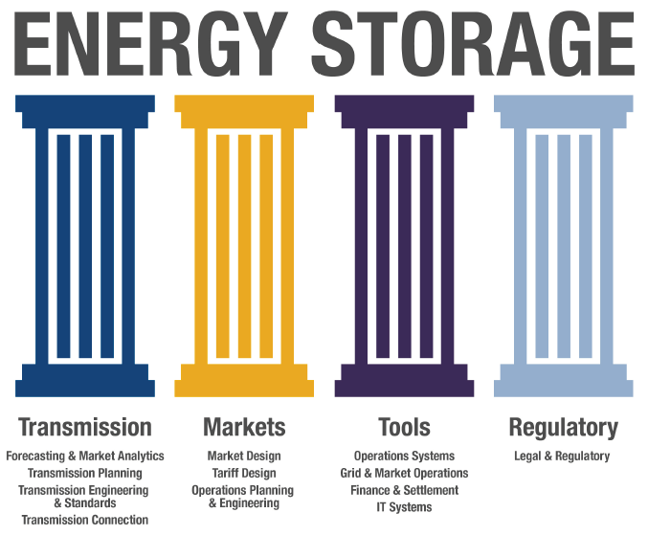
Approach
Committed
Current state
Future state
Bridge the gap
08/07/19 Public

Slide 18
Current State
The AIES currently has no transmission-connected energy storage facilities
Energy storage can participate in Alberta’s electricity markets as two separate assets, a generator or a load
Existing AESO Authoritative Documents and tools do not fully contemplate energy storage, resulting in a lack of clarity
The AESO is currently engaging stakeholders in a review of the bulk and regional tariff design
Including review of the applicable tariffs or opportunity services as they relate to energy storage
Energy-only Markets
08/07/19 Public

Slide 19
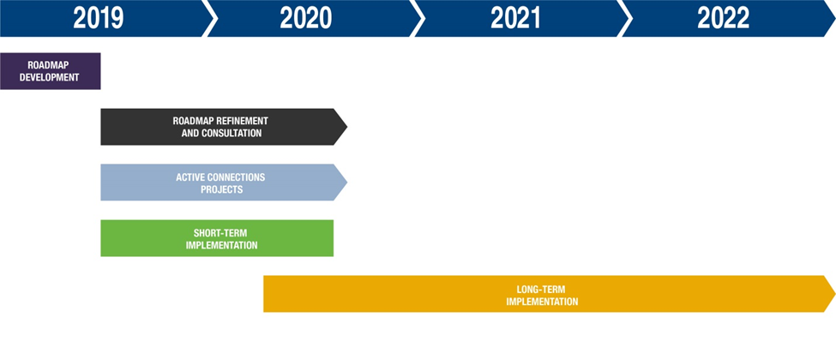
Integrated Schedule – Summary
08/07/19 Public

Slide 20
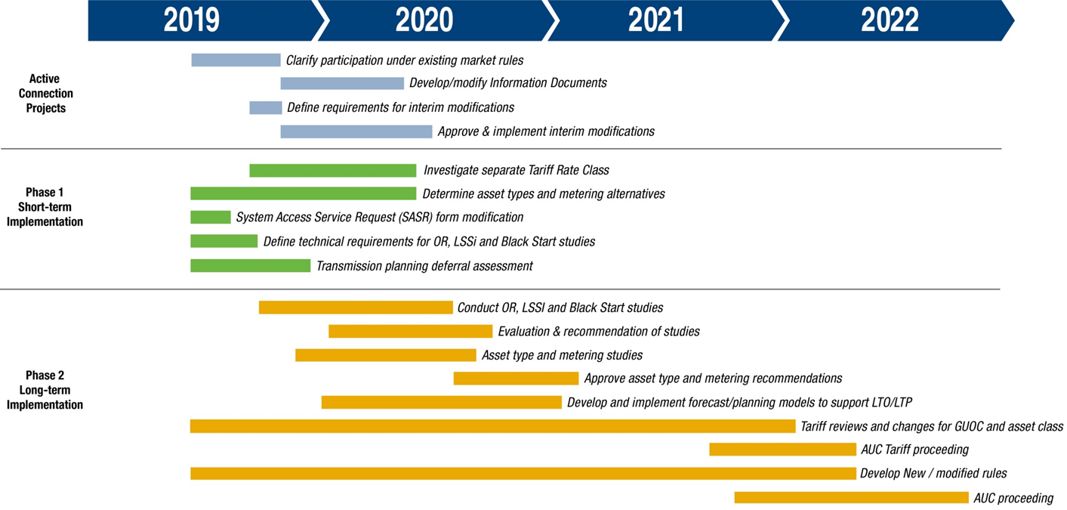
Integrated Schedule
08/07/19 Public

Slide 21
Next Steps
Energy Storage Roadmap
Published on AESO.ca this afternoon
Feedback survey
Deadline September 6, 2019
Implementation
Engage with industry
Ongoing communication
Review potential working groups
Continue Phase 1 short-term implementation
Provide clarity to enable active energy storage connection projects
08/07/19 Public

Slide 22
Questions about the Energy Storage Roadmap? Email: energystorage@aeso.ca
08/07/19 Public
22

Slide 23
Connect with the AESO
Twitter: @theAESO
Email: info@aeso.ca
Website: www.aeso.ca
Subscribe to our stakeholder newsletter
08/07/19 Public

Slide 24
Thank You
08/07/19 Public
24

