Slide 1
AESO Cluster 3
Process Overview
October 2026

Slide 2

Purpose
The purpose of this presentation is to provide Market Participants with a high-level overview of AESO’s Cluster 3 process including timelines and deliverables for the Preliminary Assessment Stage (Stage 1) and Detailed Assessment Stage (Stage 2).
Public

Slide 3
Cluster 3 Applications
The AESO received 120 applications for Cluster 3
The review of these applications took place in August and September 2026 and projects that met the requirements for acceptance into Cluster 3 are included on the October 2026 Connection Project List
106 projects, totaling over 26 GW of supply, have been accepted to proceed to Stage 1
  For information about these projects, see the Project Dashboard, List, and Map, which can be found on the Connection Project Reporting page on the AESO website.
Public

Slide 4
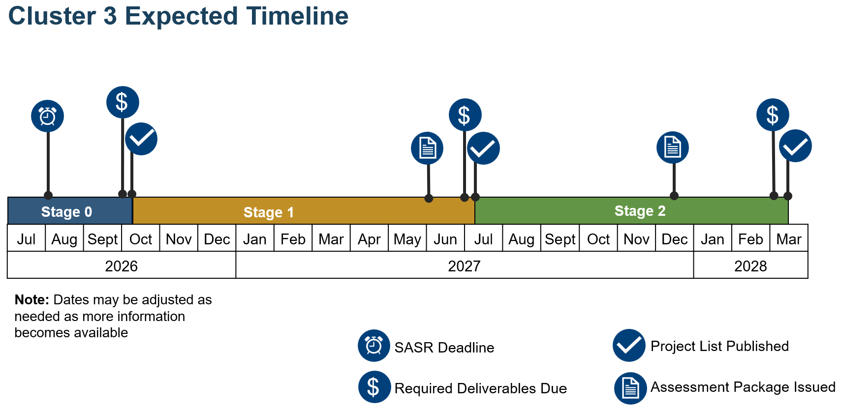
Stage 0
Stage 1
Stage 2

Slide 5
Timeline Summary
Deliverable | Target Date
Stage 1
Draft Preliminary Study Scopes Issued | December 14, 2026
Study Scope comments due | January 11, 2027
Preliminary Assessment Package issued | June 2, 2027
Detailed Assessment Fee invoice issued | June 2, 2027
Change Proposal Submissions Due | June 18, 2027
Detailed Assessment Fee Due | July 2, 2027
Stage 2
Detailed Assessment Package issued | December 2027
Change Proposal Submissions Due | January 2028
GUOC evidence/payment & TFO Stage 3&4 Security | Q1 2028

Slide 6
Stage 1 – Preliminary Assessment
Project Plan
Draft Preliminary Assessment Study Scope
  Provided by the AESO December 14, 2026. MP comments due January 11, 2027
Dynamic model review
At the end of Stage 1 (June 2, 2027), AESO will issue Preliminary Assessment Package, consisting of
  Preliminary Assessment Report
  Class 5 cost Estimate (+100/-50%)
  Detailed Assessment Fee Invoice
  Project Change Proposals can be submitted upon issuance of Preliminary Assessment Package
    Refer to the Project Change Proposal Guidelines on the AESO website for more information

Slide 7
Stage 2 – Detailed Assessment
The Stage 2 Detailed Assessment Package will consist of:
  Project-Specific Detailed Assessment Report
    Power flow, short circuit, and stability results for the study area
    Mitigation measures/list of RAS and Preferred connection alternative
  Facility Scope
  Updated Class 5 Estimate

Slide 8
Stage 2 – Detailed Assessment
Project Change Proposals can be submitted upon issuance of Detailed Assessment Packages
  Refer to the Project Change Proposal Guidelines on the AESO website for more information
MP Decision
  GUOC Evidence (Connection) or Payment (BTF)
  Stage 3 & 4 security provided to the TFO
  Reassessment Fee incurred if project cancels
    Refer to the Fee Guidelines on the AESO website for more information

Slide 9
Process Beyond Stage 2
Stage 3 – Functional Specification, SAS contract execution, regulatory preparation (if applicable)
Stage 4 – AUC applications (if applicable)
Stage 5 – Construction
Stage 6 – Close Out

Slide 10
Next Steps
AESO PMs will conduct project-specific kick-off meetings in October 2026
Project Plans to be completed by November 6, 2026
AESO will issue draft preliminary assessment study scopes on December 14th, 2026
Study scope comments submission are due on January 11, 2027
For project-specific questions, please reach out to your respective AESO PM.
Upon request, AESO PMs can also schedule further process discussions with interested Market Participants
If you haven’t already done so, please bookmark the AESO’s Cluster Assessment page and sign up for the AESO’s Stakeholder Newsletter to stay informed

Slide 11
Thank You

